Slide 1




The Present Continuous Tense

Slide 2
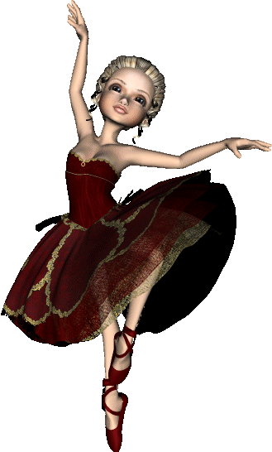
.
The girl is dancing

Slide 3
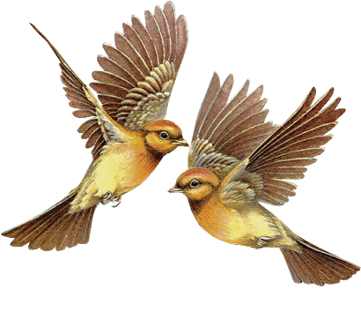
.
The birds are flying

Slide 4
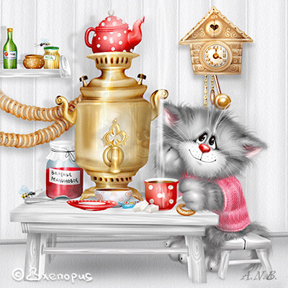
The cat is drinking tea

Slide 5


.
The girls are swimming

Slide 6

The sportsman is riding a bike

Slide 7
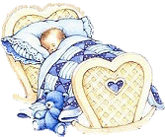
The baby is sleeping

Slide 8

.
The boy is washing

Slide 9
The Present Continuous Tense
To be + V ing
( am,is,are)
Now - cейчас

Slide 10
Translate the sentences
Я читаю книгу сейчас
Я делаю домашнее задания сейчас
Он смотрит телевизор
Она готовит
Мы играем в парке
Они разговаривают

Slide 11
Заполните пропуски. Используйте am / is / are
swimming, reading, playing, doing, eating
Listen! Dan and John … the piano.
Look! Your dog … in the river.
Where are you? – In the room. I … an interesting book.
The children … a cake.
She … her homework now.

Slide 12
Check your answers:
Listen! Dan and John are playing the piano.
Look! Your dog is swimming in the river.
Where are you? – In the room. I am reading an interesting book.
The children are eating a cake.
She is doing her homework now.

Slide 13
Choose the right verb for each gap
are dancing
is doing
am reading
are watching
am playing
are going
Look! The girl _____________ her homework.
My parents _________________ TV now.
At the moment I ______________ computer games.
The children _______________ to school.
I _______________ an interesting book now.
The man and the woman _______________ .

Slide 14
Describe the picture
It’s 7 o’clock on Monday morning. The family is in the kitchen.
Characters:
Mr. and Mrs. West - drink (пить) coffee, tea
Grandfather - read (читать) newspaper
Joe - go to school (идти в школу)
Cat Tommy - eat (есть)
Dog Bim

Slide 15

THANKS!

